Slide 1
Nonlinear ODEs and Linear PDEs Equivalence in Fluid Dynamics
John D. Ramshaw
Department of Physics, Portland State University, Portland, Oregon 97207
By Romerico David, Micah Lawal, James Minter, Mauro Sgromo
Notes:
This research was a group project for my Ordinary Differential Equations class. This is my final revision of our topic containing elements INDEPENDENT from the content and material my group presented and work together on.
Other main contributors are:
Micah Lawal, James Minter, and Mauro Sgromo

Slide 2
Problem Statement
Exploring the relations between nonlinear ordinary differential equations (ODEs) and linear partial differential equations (PDEs) within the context of fluid dynamics since this is not widely taught and is undervalued.
Solution Method
Construct solutions to certain PDEs occurring in fluid dynamics in terms of the solutions to corresponding ODEs by using the equivalence between nonlinear ODEs and linear PDEs.

Slide 3
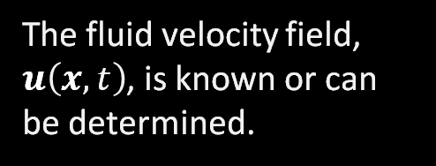
Assumptions that need to be made…
01
02
The fluid velocity field, $u\left(x,t\right)$, is known or can be determined.
The fluid velocity field are relatively
simple.
03
04
The scalar quantities being advected are non-diffusive.
The fluid motion can be described using Lagrangian surfaces

Slide 4
Unfamiliar Terms:
Advection:
Non-Diffusive Scalar:
Lagrangian Surfaces:
The movement of a mass/particle because of the fluid.
A scalar quantity that remains constant for individual fluid particles as they move through the fluid.
A surface that moves with the velocity field and the points on the surface stay in the same orientation.
Lagrangian
Trajectory:
The path a fluid particle follows as it moves through space and time

Slide 5
Lagrangian Trajectories
Definition: Lagrangian Trajectories describe the paths of fluid particles as they move through the fluid via differential equations.
Key Concept: The focus is following individual particles than looking at specific locations in space (Eulerian approach)
Key Equations:
Position vector of a Lagrangian fluid particle $x$ is governed by the nonlinear ODE $\dot{x}=u\left(x, t\right)$ where $u\left(x, t\right)$ is the velocity field
Solution $x=F(t, X)$ with $X$ as the initial position.
Reverse transformation: $X=G(t, x)$

Slide 6
Lagrangian Trajectories
Key Equations:
Position vector of a Lagrangian fluid particle $x$, is governed by the nonlinear ODE
$\dot{x}=u\left(x, t\right)$
where $u\left(x, t\right)$ is the velocity field.
The formal solution of the ODE can be expressed using the initial position $X$ at time $t=0$
$x=F(t, X)$
where $F\left(0, X\right)=X$.
We can solve $X$ to get the reverse transformation from Eulerian to Lagrangian coordinates
$$X=G(t, x)$$
where $G\left(0, x\right)=x$.

Slide 7

Lagrangian Trajectories cont…
Transformations:
From Eulerian to Lagrangian coordinates: Defined by $X=G(t, x)$
Reverse process: Defined by $x=F(t, X)$
Let’s differentiate $X=G(t, x)$ with respect to time,
$\frac{dX}{dt} = \frac{∂G(t,x)}{∂t}$
$⇒\frac{dX}{dt} = 0$ $\left(X is constant since t =0\right)=\frac{∂G(t,x)}{∂t}=\frac{∂G(t,x)}{∂t}+\frac{∂G(t,x)}{∂x}∙\frac{dx}{dt}$
$⇒0=\frac{∂G(t,x)}{∂t}+\frac{∂G(t,x)}{∂x}∙\frac{dx}{dt}$

Slide 8

Lagrangian Trajectories cont…
$⇒0=\frac{∂G(t,x)}{∂t}+\frac{∂G(t,x)}{∂x}∙u\left(x,t\right)$
$⇒0=\frac{∂G(t,x)}{∂t}+u\left(x,t\right)∙∇G(t,x(t))$
$⇒\frac{∂G}{∂t}+u∙∇G=0$
$G$ satisfies the first-order linear PDE
$\frac{∂G}{∂t}+u∙∇G=0$
which is important because it shows how transformations related to fluid particle trajectories adhere to linear dynamics even though the original ODE is nonlinear.

Slide 9
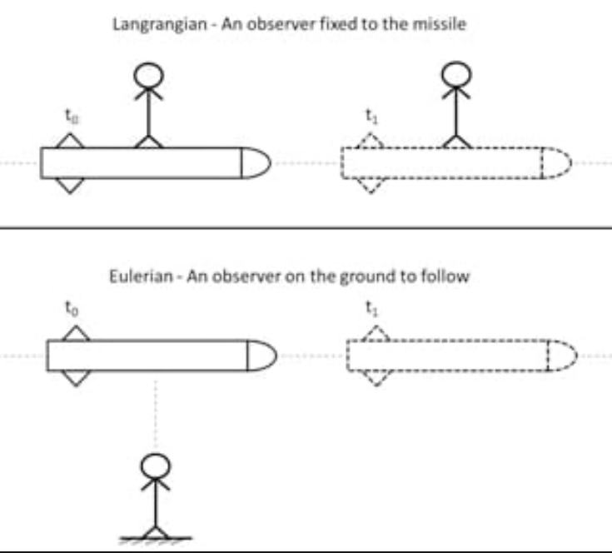
Background:
Difference Between Lagrangian & Eulerian
Lagrangian:
Focuses on tracking individual fluid particles over time
Eulerian:
Focuses on how fluid properties change at specific locations in space over time
Credit: SIMSCALE

Slide 10

Understanding the Non-Diffusive Scalar
Definition: A non-diffusive scalar $f(x,t)$ in fluid dynamics is a scalar quantity that remains constant along the trajectory of any fluid particle.
Following the equation for $x$
$f\left(x,t\right)=f_{0}\left(X\right)$ where $X$ is the initial position of the particle
which transforms to exact general solution
$$f\left(x,t\right)=f_{0}\left(G(t,x)\right)$$
from the initial condition $X=G\left(t,x\right)$
Notes:
Essentially, this means that the function f is transported by the flow without spreading out or dispersing due to molecular diffusion or other diffusive processes. Such functions are conserved along the flow lines of the velocity field, making them crucial in various applications, including the tracing of fluid elements, pollutant transport, and the study of mixing processes.

Slide 11

r.d.
Understanding the Non-Diffusive Scalar cont…
In terms of Eulerian coordinates, the scalar field satisfies the advection equation
$$\frac{∂f}{∂t}+u∙∇f=0$$
which means that the rate of $f$ is only determined by the velocity field $u$ and not other forces.
General Properties:
All non-diffusive scalars satisfy the same fundamental PDE but differ in initial conditions.
Any function of a non-diffusive scalar is itself non-diffusive.
This PDE can be solved using the method of characteristics.

Slide 12
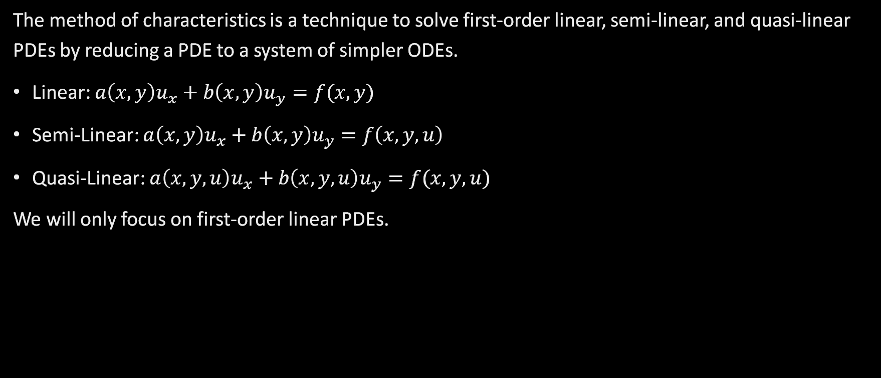
What is the Method of Characteristics?
The method of characteristics is a technique to solve first-order linear, semi-linear, and quasi-linear PDEs by reducing a PDE to a system of simpler ODEs.
Linear: $a\left(x,y\right)u_{x}+b\left(x,y\right)u_{y}=f(x,y)$
Semi-Linear: $a\left(x,y\right)u_{x}+b\left(x,y\right)u_{y}=f\left(x,y,u\right)$
Quasi-Linear: $a\left(x,y,u\right)u_{x}+b\left(x,y,u\right)u_{y}=f(x,y,u)$
We will only focus on first-order linear PDEs.

Slide 13

Simple Example using Method of Characteristics
Consider the first-order linear PDE:
$$a\left(x,t\right)u_{x}+b\left(x,t\right)u_{t}=c\left(x,t\right)$$
$=au_{x}+bu_{t}=c$
$$⇒au_{x}+bu_{t}−c=0$$
$a,b, c$ dictate the behavior of the partial derivatives $u_{x}$ and $u_{y}$ for some surface $S=u(x,y)$
By the definition of a directional derivative $D\vec{u}f\left(x,y\right)=f_{x}\left(x,y\right)∙a+f_{y}\left(x,y\right)∙b$ and the dot product $\vec{v}∙\vec{u}=v_{1}u_{1}+v_{2}u_{2}+v_{3}u_{3}$
$$au_{x}+bu_{t}−c= <a,b,c> ∙ <u_{x},u_{t},−1> =0$$
If $<a,b,c>$is perpendicular (orthogonal) to $<u_{x},u_{t},−1>$, $<a,b,c>$ lies in the tangent plane to S and we can construct a curve $C$ parametrized by $s$ such that each point on $C$, the vector $<a\left(x,t\right),b\left(x,t\right),c\left(x,t\right)>$ is tangent to the curve.
Notes:
This method is particularly useful in the context of fluid dynamics or other fields where characteristics can be used to describe the propagation of waves or the flow of fluids.
Understanding Characteristics: In the context of PDEs, characteristics are curves along which the PDE can be reduced to a system of ordinary differential equations (ODEs). These curves represent the paths along which information (like wave fronts or fluid particles) travels through the domain of the solution.
Reducing the PDE: Characteristic curves are the paths along which the PDE transforms into the set of ODEs. By following these characteristic curves, the method transforms the original PDE into simpler ODEs along these curves. Solving these ODEs provides information about the solution of the PDE along the characteristic lines.
Application to Fluid Dynamics: In fluid dynamics, the method of characteristics is particularly useful for equations describing non-diffusive scalars, where the scalar properties (like temperature, pressure, or chemical concentration) follow the flow of the fluid without dispersing into the surrounding medium. The characteristics in this case are the trajectories of the fluid particles themselves.
Outcome: The method allows for the solution of the PDE along these paths, giving insight into how these scalar properties evolve as they move with the fluid. This is especially relevant in scenarios where the properties are conserved along the flow, such as in hyperbolic equations where wave-like or flow-like behavior is modeled.

Slide 14

Simple Example using Method of Characteristics cont…
Parametrization along $s$ called characteristic curves: $C=\{ x=x\left(s\right), t=t\left(s\right), z=z\left(s\right) \}$
Following chain rule $\frac{dz}{ds}=\frac{∂z}{∂x}\frac{dx}{ds}+\frac{∂z}{∂t}\frac{dt}{ds}=u_{x}a+u_{t}b=c$
Matching coefficients:
$\frac{dx}{ds}=a(x,t)$
$\frac{dt}{ds}=b(x,t)$
$\frac{dz}{ds}=c(x,t)$
Notes:
This method is particularly useful in the context of fluid dynamics or other fields where characteristics can be used to describe the propagation of waves or the flow of fluids.
Understanding Characteristics: In the context of PDEs, characteristics are curves along which the PDE can be reduced to a system of ordinary differential equations (ODEs). These curves represent the paths along which information (like wave fronts or fluid particles) travels through the domain of the solution.
Reducing the PDE: Characteristic curves are the paths along which the PDE transforms into the set of ODEs. By following these characteristic curves, the method transforms the original PDE into simpler ODEs along these curves. Solving these ODEs provides information about the solution of the PDE along the characteristic lines.
Application to Fluid Dynamics: In fluid dynamics, the method of characteristics is particularly useful for equations describing non-diffusive scalars, where the scalar properties (like temperature, pressure, or chemical concentration) follow the flow of the fluid without dispersing into the surrounding medium. The characteristics in this case are the trajectories of the fluid particles themselves.
Outcome: The method allows for the solution of the PDE along these paths, giving insight into how these scalar properties evolve as they move with the fluid. This is especially relevant in scenarios where the properties are conserved along the flow, such as in hyperbolic equations where wave-like or flow-like behavior is modeled.

Slide 15

Simple Example using Method of Characteristics cont…
Thus we have the set of characteristic equations given as:
$\frac{dx}{ds}=a(x(s),t(s))$
$\frac{dt}{ds}=b(x\left(s\right),t\left(s\right))$
$\frac{dz}{ds}=c(x(s),t(s))$
Our linear PDE was reduced into a system of ODES where we can use our knowledge of ODEs to solve the characteristic equations.
Notes:
This method is particularly useful in the context of fluid dynamics or other fields where characteristics can be used to describe the propagation of waves or the flow of fluids.
Understanding Characteristics: In the context of PDEs, characteristics are curves along which the PDE can be reduced to a system of ordinary differential equations (ODEs). These curves represent the paths along which information (like wave fronts or fluid particles) travels through the domain of the solution.
Reducing the PDE: Characteristic curves are the paths along which the PDE transforms into the set of ODEs. By following these characteristic curves, the method transforms the original PDE into simpler ODEs along these curves. Solving these ODEs provides information about the solution of the PDE along the characteristic lines.
Application to Fluid Dynamics: In fluid dynamics, the method of characteristics is particularly useful for equations describing non-diffusive scalars, where the scalar properties (like temperature, pressure, or chemical concentration) follow the flow of the fluid without dispersing into the surrounding medium. The characteristics in this case are the trajectories of the fluid particles themselves.
Outcome: The method allows for the solution of the PDE along these paths, giving insight into how these scalar properties evolve as they move with the fluid. This is especially relevant in scenarios where the properties are conserved along the flow, such as in hyperbolic equations where wave-like or flow-like behavior is modeled.

Slide 16

Understanding the Non-Diffusive Scalar cont…
So, when we solve the PDE
$$\frac{∂f}{∂t}+u∙∇f=0$$
using the method of characteristics will result in a system of characteristic equations that will give us the same exact general solution under the same initial conditions
$$f\left(x,t\right)=f_{0}\left(G(t,x)\right)$$

Slide 17

Lagrangian Surfaces in Fluid Dynamics
Definition: A Lagrangian surface$S(t)$is a collection of fluid particles that move with the fluid velocity field $u(x,t)$ to form a coherent surface.
The initial surface $S(0)$ can be parameterized by a function $Q_{0}\left(α,β\right)$ defined by
$$X=Q_{0}\left(α,β\right)$$
Example: A sphere parameterized by spherical coordinates evolving over time.
The Lagrangian surface at a later time $t$ can be defined by
$x=Q(t,α,β)$ where $Q\left(t,α,β\right)=F(t,Q_{0}(α,β)$
which represents the new position of the fluid particles as they move with the fluid.

Slide 18

Example: Incompressible Spherically Symmetric Radial Velocity Field in Spherical Coordinates
Given the velocity field:
$$\vec{u}=u\left(r,t\right)\vec{e_{r}}$$
where $\vec{e_{r}}$ is the radial unit vector.
The advection equation in spherical coordinates for an incompressible fluid is given by:
$$∇∙\vec{u}=\frac{1}{r^{2}}\frac{∂}{∂r}(r^{2}u)=0$$
Notes:
where $a(t)$ is an arbitrary function of time (and $\vec{e_{r}}$ is the unit vector in the radial direction).

Slide 19

Example: Incompressible Spherically Symmetric Radial Velocity Field in Spherical Coordinates
Integrating the advection equation:
$$\frac{∂}{∂r}(r^{2}u)=0$$
$$⇒r^{2}u=a(t)$$
$$⇒u\left(r,t\right)=\frac{a(t)}{r^{2}}$$
The position vector $x$ in spherical coordinates is given as:
$$x=r\vec{e_{r}}$$
So
$$\dot{x}=\frac{d}{dt}\left(r\vec{e_{r}}\right)=\dot{r}e_{r}+\dot{re_{r}}=\frac{a(t)}{r^{2}}\vec{e_{r}}$$

Slide 20

Example: Incompressible Spherically Symmetric Radial Velocity Field in Spherical Coordinates
The position vector $x$ in spherical coordinates is given as:
$$x=r\vec{e_{r}}$$
So
$$\dot{x}=\frac{d}{dt}\left(r\vec{e_{r}}\right)=\frac{dr}{dt}\vec{e_{r}}+r\frac{d\vec{e_{r}}}{dt}=\frac{a(t)}{r^{2}}\vec{e_{r}}$$
Using the identity $e_{r}∙e_{r}=1⇒\dot{e_{r}∙e_{r}=0}$. This mean that $\dot{e_{r}}$ is orthogonal to $e_{r}$ meaning it does not contribute to the radial component.
$$\left[\frac{dr}{dt}\vec{e_{r}}+r\frac{d\vec{e_{r}}}{dt}\right]∙\vec{e_{r}}=\left[\frac{a\left(t\right)}{r^{2}}\vec{e_{r}}\right]∙\vec{e_{r}}$$
So, the equation reduces to $\dot{r}=\frac{a(t)}{r^{2}}$
Notes:
Imagine a particle moving outward radially. The radial component of its velocity is directly aligned with e_r, while any orthogonal movement (e.g., changes in direction) does not affect the radial distance r.
By focusing on the radial direction and recognizing orthogonality, we can simplify the expression.

Slide 21

Example: Incompressible Spherically Symmetric Radial Velocity Field in Spherical Coordinates
$a(t)$ can be eliminated in terms of the time dependence by using a particular reference Lagrangian radius $R(t)$ satisfying our radial velocity,
This means we can define $r=R(t)$ as the radius of the unperturbed interface which is the boundary between the particle and surface but remains unaffected by other variables since the surface is a nearly spherical interface thus its geometry cancels opposing inertial forces.
Thus, $\dot{R}=\frac{a(t)}{R^{2}}⇒a\left(t\right)=R^{2}\dot{R}$.
So, $\dot{r}=\frac{R^{2}\dot{R}}{r^{2}}$
Notes:
Lagrangian radius refers to a specific radius in a fluid that moves with the fluid flow. This is a reference radius that traces the motion of a particle that was initially at R(0) at time t=0.
Radial Velocity: The equation dR/dT = a(t)/R^2 is derived from the general radial velocity expression u(r,t)=a(t)/r^2 applied specifically at r=R(t).
This allows us to determine and perform calculation on a(t) based on the behavior of the rate of change R(t), eliminating the need to separately determine a(t). This simplifies the analysis of the fluid motion because it links a(t), a potentially complex function of time that affects the entire velocity field, to the motion of a specific radius. This is particularly useful when R(t) is of simpler form making the entire fluid’s behavior easier to model or predict.
This means we can define $r=R(t)$ as the radius of the unperturbed interface which is the boundary between two materials but remains unaffected by other variables since the problem being solved is a nearly spherical interface between two materials that are ubiquitous in inertial confinement fusion

Slide 22

Example: Incompressible Spherically Symmetric Radial Velocity Field in Spherical Coordinates
Solving $\dot{r}=\frac{R^{2}\dot{R}}{r^{2}}$
$$⇒r^{2}dr=R^{2}dR$$
Assuming $r(0)=r_{0}$ and $R(0){=R}_{0}$
$$⇒\int_{r_{0}}^{r}{r^{2}dr}=\int_{R_{0}}^{R}{R^{2}dR}$$
$$⇒r={\left[R^{3}\left(t\right)−R_{0}^{3}+r_{0}^{3}\right]}^{\frac{1}{3}}$$
OR
$$⇒r_{0}={\left[R^{3}\left(t\right)−R_{0}^{3}+r^{3}\right]}^{\frac{1}{3}}$$
Where $r_{0}$ is the radial coordinate of $X$

Slide 23

Example: Incompressible Spherically Symmetric Radial Velocity Field in Spherical Coordinates
According to our non-diffusive scalar function with the initial condition $f_{0}\left(r_{0},θ,φ\right)$ at $t=0$, the exact general solution is
$$f\left(r,θ,φ,t\right)=f_{0}\left({\left[R^{3}\left(t\right)−R_{0}^{3}+r^{3}\right]}^{\frac{1}{3}},θ,φ\right)$$
Additionally, using the method of characteristics on the advection equation $\frac{∂f}{∂t}+u∙∇f=0$ where $u\left(r,t\right)=\frac{a(t)}{r^{2}}$ will give us the same exact general solution
$$f\left(r,θ,φ,t\right)=f_{0}\left({\left[R^{3}\left(t\right)−R_{0}^{3}+r^{3}\right]}^{\frac{1}{3}},θ,φ\right)$$
with the initial condition $f_{0}\left(r_{0},θ,φ\right)$ at $t=0$.

Slide 24

Example: Incompressible Spherically Symmetric Radial Velocity Field in Spherical Coordinates
The surface is initially defined by $r_{0}=Q_{0}(θ,φ)$ at $t=0.$
The radius of the surface at a later time $t$ is defined by $r={\left[R^{3}\left(t\right)−R_{0}^{3}+Q_{0}^{3}(θ,φ)\right]}^{\frac{1}{3}}.$
This shows how the radius $r$ evolves from its initial configuration through some Lagrangian deformation $R\left(t\right)$. The aim is to ensure that deformation from $r_{0}$ to $r$ preserves the volumed enclosed by the surface meaning every point on the initial surface retains its volume at later times.
Since they both states are Lagrangian, if the initial condition is satisfied, then all later conditions will also be satisfied. So, we can define $R_{0}$ by
$$\frac{4π}{3}R_{0}^{3}=\int{\int{sinθdθ}dφ}\int_{0}^{Q_{0}}{r^{2}dr}=\frac{1}{3}\int{\int{Q_{0}^{3}(θ,φ)sinθdθdφ}},0≤θ≤2π,−π≤φ≤π$$
Notes:
This triple integral is the formula for calculating the volume of a triple integral with spherical coordinates.

Slide 25

Example: Incompressible Spherically Symmetric Radial Velocity Field in Spherical Coordinates
Volume Conservation: Since both states are Lagrangian, if the initial condition is satisfied, then all later conditions will also be satisfied. So, we can define $R_{0}$ by
$$\frac{4π}{3}R_{0}^{3}=\int{\int{sinθdθ}dφ}\int_{0}^{Q_{0}}{r^{2}dr}$$
$$=\frac{1}{3}\int{\int{Q_{0}^{3}(θ,φ)sinθdθdφ}},0≤θ≤2π,−π≤φ≤π$$
This step describes the mathematical formulation for how a deformable and spherically influenced fluid surface evolves over time while conserving its volume to set the stage for further analysis of such a system.
Notes:
If we had experience in creating 3D models, we could show how volume is conserved following this formula.

Slide 26

Simulation
Using the nonlinear ODE:
$$\dot{r}=\frac{a(t)}{r^{2}}$$
We set $a\left(t\right)=t$, a simple function of time
which results to
$$\dot{r}=\frac{t}{r^{2}}$$

Slide 27

Simulation: Euler’s Method
General Formula:
$$r_{n+1}=r_{n}+h∙\dot{r}(t_{n},r_{n})$$
where $h$ is the time step and $\dot{r}\left(t_{n},r_{n}\right)=\frac{t_{n}}{r_{n}^{2}}$
Initial Conditions: $r_{0}=1$
$t_{0}=0$
$t_{f}=10$
$h=0.01$
Notes:
Euler’s Method is a way to approximate ODEs under various initial conditions.

Slide 28
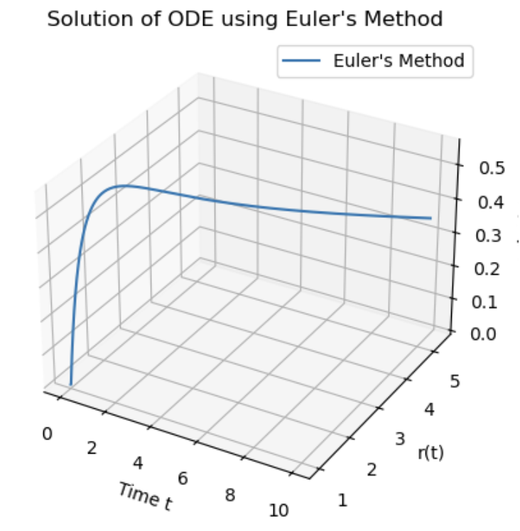
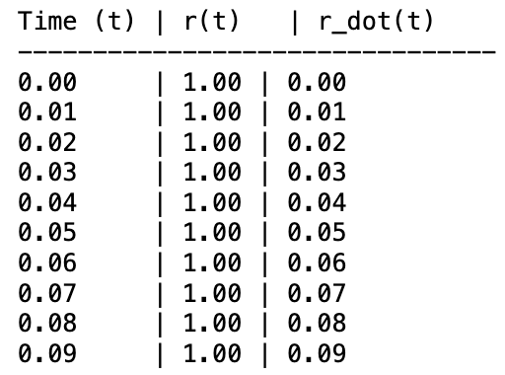
Simulation: Euler’s Method Graphical Plot in 3D and Table Results

Slide 29
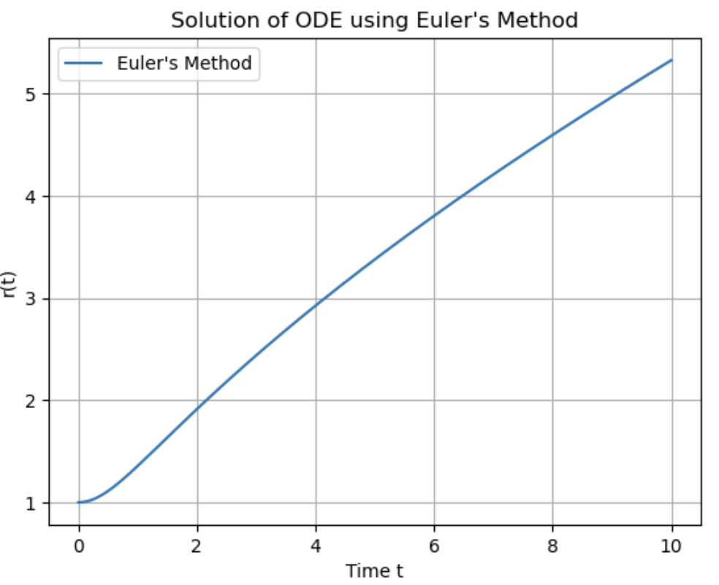
Simulation: Euler’s Method Graphical Plot in 2D

Slide 30

Simulation: Runge-Kutta Method
Runge-Kutta Method uses four intermediate step to compute the next value of $r$
Intermediate Slopes:
$$k_{1}=h∙f(t_{n},r_{n})$$
$$k_{2}=h∙f\left(t_{n}+\frac{h}{2}, r_{n}+\frac{k_{1}}{2}\right)$$
$$k_{3}=h∙f(t_{n}+\frac{h}{2}, r_{n}+\frac{k_{2}}{2})$$
$$k_{4}=h∙f(t_{n}+h, r_{n}+k_{3})$$
Notes:
Runge-Kutta method is another way to approximate ODEs under various initial conditions. It is integrated in our model when we use the solve_ivp() function from the Scipy library.

Slide 31

Simulation: Runge-Kutta Method
We can now define our formula
$$r_{n+1}=r_{n}+\frac{h}{6}(k_{1}+2k_{2}+2k_{3}+k_{4})$$
and updating time using the formula
$$t_{n+1}=t_{n}+h$$

Slide 32
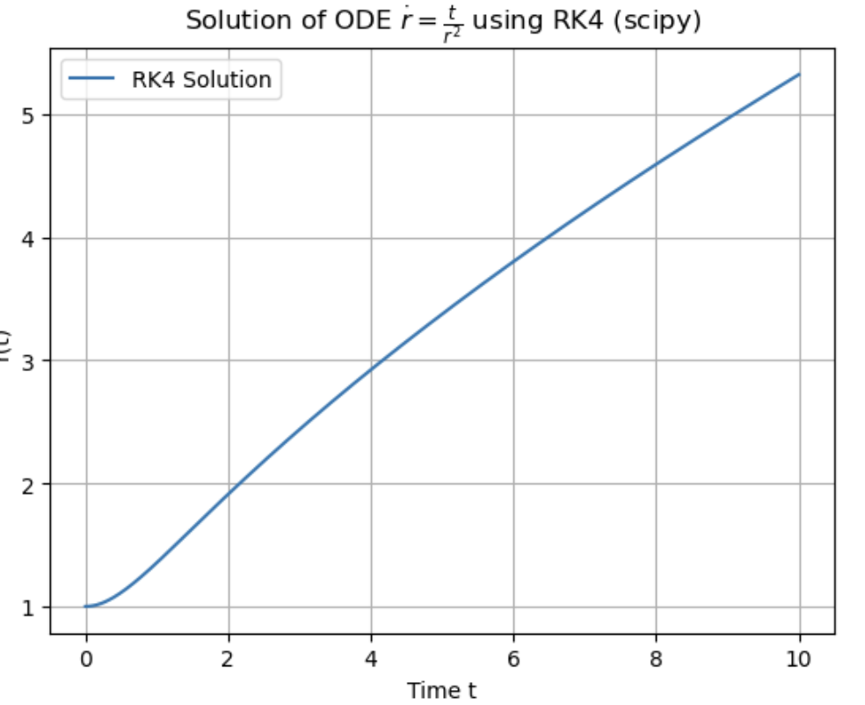
Runge-Kutta Method Graphical Plot in 2D

Slide 33

Simulation: Results
Velocity Field:
In spherical coordinates, our spherically symmetric radial velocity field $\vec{u}=u\left(r,t\right)\vec{e_{r}}$ means that the velocity of fluid particles is directed radially outward and depends only on the radial distance $r$ and time $t$.
Incompressibility:
Incompressibility means the volume of any fluid element remains constant over time. This means volume is conserved if the deformation from $r_{0}$ to $r$ remains constant
Notes:
In principle, since this nonlinear ODEs is equivalent to our linear PDE, if we knew methods to model PDEs, we will get the same results.

Slide 34

Simulation: Results
Our simulations show that the radial displacement 𝑟 steadily increases radially outward with time 𝑡 under the influence of the velocity field. The deformation (slope) from initial radius $r_{0}$ to any radius 𝑟 remains constant, showing volume is conserved in our system. Given that the ODE $\dot{r}=\frac{a(t)}{r^{2}}$ is equivalent to the PDE $\frac{1}{r^{2}}\frac{∂}{∂r}(r^{2}u)=0$, we expect similar results if we knew methods of modeling PDEs.
Notes:
In principle, since this nonlinear ODEs is equivalent to our linear PDE, if we knew methods to model PDEs, we will get the same results.

Slide 35

New Variable
We include the effects of pressure and viscosity in the radial component of the Navier-Stokes equations for an incompressible fluid. The general form of the Navier-Stokes equation for radial velocity $u(r)$ in spherical coordinates, ignoring external forces like gravity for simplicity, is:
$$ρ\left(\frac{∂u}{∂t}+u\frac{∂u}{∂r}\right)=−\frac{∂p}{∂r}+μ\left(\frac{∂^{2}u}{∂r^{2}}+\frac{2}{r}\frac{∂u}{∂r}−\frac{2u}{r^{2}}\right)$$
Let's assume that the velocity field $u(r)=\frac{C}{r^{2}}$ is steady, so $\frac{∂u}{∂t}=0$ , then compute the derivatives:​
$$\frac{∂u}{∂r}=−\frac{2C}{r^{3}}​$$
$$\frac{∂^{2}u}{∂r^{2}}=\frac{6C}{r^{4}}$$

Slide 36

New Variable cont…
Substituting these into the viscous term
$$μ\left(6\frac{C}{r^{4}}+\frac{2}{r}(−\frac{2C}{r^{3}})−\frac{2\frac{C}{r^{2}}}{r^{2}}\right)=μ\left(6\frac{C}{r^{4}}−\frac{4C}{r^{4}}−\frac{2C}{r^{4}}\right)=0$$
We can get a simplified equation
$$−\frac{∂p}{∂r}=ρ\left(−\frac{2C}{r^{5}}\right)⇒\frac{∂ρ}{∂r}=2ρ\frac{C}{r^{5}}$$
We then integrate the pressure gradient and are left with
$$p\left(r\right)=−2ρ\frac{C^{2}}{3r^{4}}+p_{0}$$

Slide 37

New Variable cont…
$$p\left(r\right)=−2ρ\frac{C^{2}}{3r^{4}}+p_{0}$$
With $C^{2}$ determined by boundary conditions, such as specifying the velocity at a certain radius. The pressure varies inversely with the fourth power of the radius, illustrating how pressure gradients necessary to maintain such a flow increase sharply as $r$ decreases.
This derivation encapsulates the interaction between the radial velocity profile and the pressure in a spherically symmetric, incompressible flow, showcasing the direct dependence of the pressure gradient on the square of the radial velocity field.
If we had more time, we would use this pressure equation added to our radial velocity to confirm whether the equivalence still holds true.

Slide 38
Q&A

Slide 39
References
Hautala, S. (2020). Advection-Diffusion Equation. In Physics Across Oceanography: Fluid Mechanics and Waves. University of Washington Pressbooks. Retrieved from https://uw.pressbooks.pub/ocean285/chapter/advection-diffusion/
Pirola, A. (n.d.). Probability and Statistical Mechanics. Retrieved from https://www.science.unitn.it/~pignatel/PoAV/talks/Pirola.pdf
Ramshaw, J. D. (2011). Nonlinear ordinary differential equations in fluid dynamics. American Journal of Physics, 79(12), 1255-1260. https://doi.org/10.1119/1.3636635
ScienceDirect Topics. (n.d.). Runge-Kutta Method. Retrieved from https://www.sciencedirect.com/topics/mathematics/runge-kutta-method
Smyth, B. (n.d.). Lagrangian and Eulerian descriptions. In All Things Flow - Fluid Mechanics for the Natural Sciences. LibreTexts. Retrieved from https://eng.libretexts.org/Bookshelves/Civil_Engineering/Book%3A_All_Things_Flow_-_Fluid_Mechanics_for_the_Natural_Sciences_(Smyth)/05%3A_Fluid_Kinematics/5.01%3A_Lagrangian_and_Eulerian_descriptions
Virtanen, P., Gommers, R., Oliphant, T. E., Haberland, M., Reddy, T., Cournapeau, D., ... & van Mulbregt, P. (2023). scipy.integrate.solve_ivp [Documentation]. SciPy. Retrieved from https://docs.scipy.org/doc/scipy/reference/generated/scipy.integrate.solve_ivp.html
YouTube. (2023). How to Solve PDEs and ODEs Using Euler's Method [Video]. YouTube. https://www.youtube.com/watch?v=jdq6puyvQ7E&t=78s

